Slide 1
A Rose for Emily
William Faulkner
Introduction to English Literature
March 29 - April 9

Slide 2

Zombie’s “A Rose For Emily”
Notes:
The Zombies(An English rock band), "A Rose for Emily"(1968)
The summer is here at last
The sky is overcast
And no one brings a rose for Emily
She watches her flowers grow
While lovers come and go
To give each other roses from her tree
But not a rose for Emily...
Emily, can't you see (how the sun is shining again)
There's nothing you can do?
There's loving everywhere
But none for you...
Her roses are fading now
She keeps her pride somehow
That's all she has protecting her from pain
And as the years go by
She will grow old and die
The roses in her garden fade away
Not one left for her grave
Not a rose for Emily...
Emily, can't you see (how the sun is shining again)
There's nothing you can do?
There's loving everywhere
But none for you...
Her roses are fading now
She keeps her pride somehow
That's all she has protecting her from pain
And as the years go by
She will grow old and die
The roses in her garden fade away
Not one left for her grave
Not a rose for Emily...

Slide 3
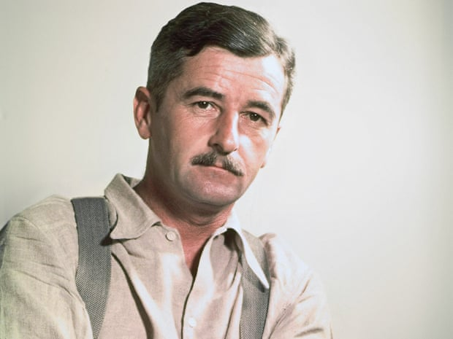
William Faulkner Biography
one of America's greatest novelists and a Nobel Prize-winner.
a unique blend of high modernism and Southern localism.
His trademarks include family decline, incest, race relations, vengeance, madness, memory, haunting and violence, enacted often without clear cause or principle and without poetic justice, but overseen by an implacable fate.

Slide 4
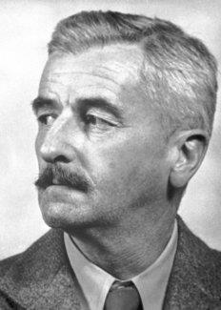
William Faulkner Biography
born in New Albany, Mississippi on 25 September 1897, the eldest of four sons of Maud and Murry Falkner.
not an a big fan of school, often playing truant and finally leaving in eleventh grade.
died on 6 July 1962, having become ill after a bad fall from a horse.

Slide 5
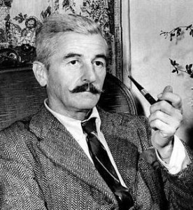
William Faulkner Biography
Faulknerian technique of multiple viewpoints.
Yoknapatawpha tales.
Faulknerian theme of memory and family ghosts.
Symbolism and fragmentation and creating characters more of ideas than flesh and blood.
The decline of a Southern family.

Slide 6
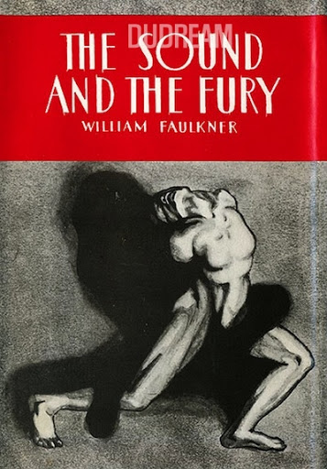
William Faulkner’s Novels
The Sound and the Fury (1929): the decline of a Southern family, exemplified by the gradual disintegration of a figure who is given no voice of her own, Caddy Compson.

Slide 7
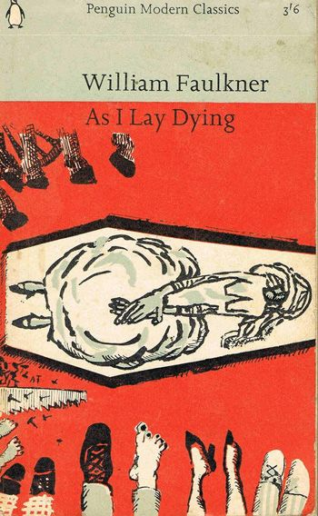
William Faulkner’s Novels
As I Lay Dying (1930): the story, in fifteen intermingled voices, of the poor-white Bundren family's journey to bury their matriarch Addie Bundren in her home town of Jefferson, a story of pride and stoicism.

Slide 8

William Faulkner’s Novels
Light in August (1932):the stories of Joe Christmas, a drifter turned murderer when his affair with a lady of a higher class ends with her renunciation of him.

Slide 9
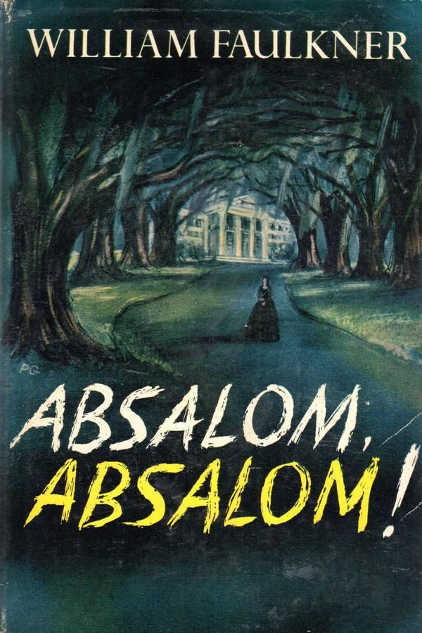
William Faulkner’s Novels
Absalom Absalom! (1936): a 'collection of narratives gathered in the consciousness of the doomed Quentin Compson,’ whom we meet at Harvard, some months before his suicide.

Slide 10
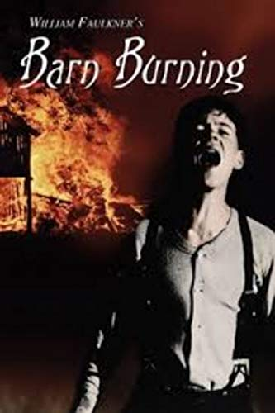

Adaptation of Faulkner’s Story

Slide 11
William Faulkner’s Novels
‘Barn Burning’: “Barn Burning” is a 1939 short story by William Faulkner about a vengeful, abusive father and his son.
Ten-year-old Colonel Satoris "Sarty" Snopes has an abusive, alcoholic father who beats Sarty mercilessly and burns down his employers’ barns.
They visit the house of Major de Spain, a rich gentleman. Resentful of de Spain, Snopes tracks dung onto one of de Spain's carpets.
A judge orders Snopes to pay a fine. Snopes makes plans to burn de Spain's barn. Sarty attempts to warn de Spain but hears shots that night and assumes his father has been killed.
“버닝”: 무라카미 하루키의 단편소설 <헛간을 태우다>가 원작. 윌리엄 포크너의 1939년작 Barn Burning도 작품에 영향을 미쳤다. 이창동 감독은 "하루키의 세계에 살고 있는 젊은 포크너의 이야기"라고 함.
젊은 소설가 지망생 종수가 어린 시절 친구인 해미를 만나서 애정을 느낌.
정체를 알 수 없는 해미를 통해 상류층 남자 벤을 알게 됨.
종수는 벤에게 연적으로서의 질투심과 계급적 적대감을 느낌.
종수는 벤이 해미를 죽였고, 방화를 했을지 모른다고 생각함.
그 사실은 확인되지 않았지만, 오히려 종수가 벤을 살해하고 방화함.

Slide 12
What is Character?
Definition: any personage in a literary work who acts, appears, or is referred to as playing a part.
Things to check when reading a fiction about characters: name, physical appearance, objects and places associated with it, actions, thoughts and speech, comments, narrator's comments about the character.

Slide 13
Kinds of Characters
Old, Classic Fictions: Hero or Heroine("good guy") vs villain("bad guy").
Modern Fictions prefers more neutal terms: Protagonist vs Antagonist.
“Antihero”: a hero possessing traits that make him or her the opposite of a traditional hero difficult to like or admire.
Protagonist’s outlook does not necessarily coincide with that of the author’s. Neither does it depend on the likability of the protagonist whether the story is a good one or not.

Slide 14
Kinds of Characters
Minor characters are just as important as Major characters.
a Foil, a character that helps by way of contrast to reveal the unique qualities of another (especially main) character.
Flat characters are simple, one-dimensional characters that behave and speak in predictable or repetitive whereas Round characters have psychological complexity.
Dynamic characters are changing whereas Static characters are not changing.
Stock characters seem to be out of a stockroom of familiar, prefabricated figures whereas Archetypes recurring in the myths and literature of many different ages and cultures.

Slide 15
Characterization
The art and technique of representing fictional personages.
Things to consider:
  how the text shapes our interpretation of, and degree of sympathy or admiration for, the character.
  what function the character serves in the story.
  what the character might represent.

Slide 16
Character is Fate
Heraklitos, a Greek philosopher thought that character, the essence of the individual, determines his or her experience; Character, the tone of the individual, resonates with the music of his destiny. It is the flaws of character that are tragic. Viewing destiny in this way, the fates are not outside us, in the heavens, weaving and cutting the threads of our lives. Instead, they are consonant with our character. This consideration is at the root of the world view that good things happen to good people.

Slide 17
A Rose for Emily
Faulkner’s first short story published in a notable magazine called Forum on April 30, 1930.
Dealing primarily with the cultural shifts that occurred in the post-Civil War South.
One of many of Faulkner’s works, such as Sartoris, to be set in fictional Yoknapatawpha County, Mississippi.
A non-chronological structure to tell the story of Emily Grierson,
a faded Southern belle, dies after leading an isolated life.
People’s recollection of Emily’s scandalous relationship with a Northern laborer named Homer Barron.
Sometimes read as an allegory for the resistance of the Old South.

Slide 18
The chronological order of the events in the text
1. Homer's arrival in town
2. The aldermen's visit
3. Emily's purchase of poison
4. Colonel Sartoris's decision to remit Emily's taxes
5. The development of the odor
6. Emily's father's death
7. The arrival of Emily's relatives
8. Homer's disappearance

Slide 19
Key Questions
Why weren't there suitable suitors for Emily?
Why does Emily take up with Homer Barron?
What happened when he left? Did he abandon her? Why did he come back?
Why did she kill him?
Why did the smell disappear after only one week?
How did the hair come to be on the pillow?
Did she lie beside the corpse? How often, for what period of years?
Why did she not leave the house for the last decade of her life?
How crazy was she (unable to distinguish fantasy from reality)?
Why does she allow so much dust in her house?

Slide 20
Exposition
It was a big, squarish frame house that had once been white, decorated with cupolas and spires and scrolled balconies in the heavily lightsome style of the seventies, set on what had once been our most select street. But garages and cotton gins had encroached and obliterated even the august names of that neighborhood; only Miss Emily's house was left, lifting its stubborn and coquettish decay above the cotton wagons and the gasoline pumps-an eyesore among eyesores(295/628).
Notes:
A Setting of the Story. Showing the relationship Miss Emily had with the townspeople.
Question: how could Miss Emily’s house be described as having “stubborn and coquettish decay”? What does it mean? And what does it show about the following story?

Slide 21
Miss Emily as a Tradition
Alive, Miss Emily had been a tradition, a duty, and a care; a sort of hereditary obligation upon the town, dating from that day in 1894 when Colonel Sartoris, the mayor--he who fathered the edict that no Negro woman should appear on the streets without an apron-remitted her taxes, the dispensation dating from the death of her father on into perpetuity(295/628).
Notes:
When Mr Grierson, Emily’s father was alive, that is, before the Confederate army was defeated by the Union army, Miss Emily was a noble lady, unreachable for the common people. Now she became something else. And what is it? Why did she became “a duty and a care” rather than someone to look up to. What story did Colonel Sartoris invent and why?

Slide 22
Emily's Appearance
They rose when she entered--a small, fat woman in black, with a thin gold chain descending to her waist and vanishing into her belt, leaning on an ebony cane with a tarnished gold head. Her skeleton was small and spare; perhaps that was why what would have been merely plumpness in another was obesity in her. She looked bloated, like a body long submerged in motionless water, and of that pallid hue. Her eyes, lost in the fatty ridges of her face, looked like two small pieces of coal pressed into a lump of dough as they moved from one face to another while the visitors stated their errand(296/629).
Notes:
Emily looked like a dead body from the beginning. The only part alive was her black eyes eerily sparkling. Why was she described in that way? How did she beat off the delegation’s demand to pay tax. What does it mean, having to pay tax? It means that she does no longer belong to a privileged class that have no tax to pay. Demanding her to pay tax means that they are now going to tread her as a normal citizen like everybody else, Emily of course resolutely rejected it. Emily refuses to accept the reality where there in no privilege for them. In that sense, she is like a dead body, which is why she is here described as a drowned body.

Slide 23
People's changed attitude
That was when people had begun to feel really sorry for her. People in our town, remembering how old lady Wyatt, her great-aunt, had gone completely crazy at last, believed that the Griersons held themselves a little too high for what they really were. None of the young men were quite good enough for Miss Emily and such. We had long thought of them as a tableau, Miss Emily a slender figure in white in the background, her father a spraddled silhouette in the foreground, his back to her and clutching a horsewhip, the two of them framed by the back-flung front door. So when she got to be thirty and was still single, we were not pleased exactly, but vindicated; even with insanity in the family she wouldn't have turned down all of her chances if they had really materialized(297/630).
Notes:
People, particularly those of old generation, tend to keep a traditional respect to pay to the person like Emily who reminds them of the old times. But even those people realized that the world had changed. Emily, who refuses to accept such change, became an “eyesore” even to the people who used to be sympathetic to her. Seeing that Emily is growing old as a spinster, they are now able to “feel really sorry for her” But why weren’t they pleased with Emily’s misfortune of growing old as a spinster? What does it mean that they were “vindicated”? Vindicated about what?

Slide 24
People's capriciousness
At first we were glad that Miss Emily would have an interest, because the ladies all said, "Of course a Grierson would not think seriously of a Northerner, a day laborer." But there were still others, older people, who said that even grief could not cause a real lady to forget noblesse oblige- -(298/631)
Notes:
People felt sorry for Emily who could not find a suitable match, but when she found one, they were disappointed. They were happy with the fact that Emily came down in social hierarchy, low enough to be an object of “charity”. Now they became more aristrocrat than Emily herself blaming her for her choice of husband from Northerners, people with no background!
Who is the narrator? A third person limited, perhaps of one of the townspeople, but a bit aloof from all of them, Assuming a neutral position, but a little bit sarcastic, but slightly towards Emily.

Slide 25
Final Scene: uncovering Emily's secret marriage
For a long while we just stood there, looking down at the profound and fleshless grin. The body had apparently once lain in the attitude of an embrace, but now the long sleep that outlasts love, that conquers even the grimace of love, had cuckolded him. What was left of him, rotted beneath what was left of the nightshirt, had become inextricable from the bed in which he lay; and upon him and upon the pillow beside him lay that even coating of the patient and biding dust. Then we noticed that in the second pillow was the indentation of a head. One of us lifted something from it, and leaning forward, that faint and invisible dust dry and acrid in the nostrils, we saw a long strand of iron-gray hair(301/634).
Notes:
What does the final scene disclose? What does it mean that “the long sleep” “cuckolded” him? Why the second pillow has the “indentation” What does it mean that they found “a long strand of iron-gray hair?”

